Slide 1

Bijan Paul
Senior Lecturer
East West University
Notes:
Anyone already familiar with HTML?
Disclaimer: I do not work in HTML very often.

Slide 2

Introduce HTML
Hand Code your project in HTML

Slide 3

No clear favorites among tools and techniques for “Internet documentation.”
Format can be:
  Hand-coded HTML
The most significant requirement is some knowledge of HTML.
Notes:
We will be working with Dreamweaver later in the quarter, but first it is important to learn a little bit of html so you can troubleshoot and edit on your own.
MySpace Users? Already probably know a little html.

Slide 4

HTML: Hypertext Markup Language, the format used on the World Wide Web.
HTTP: Hypertext Transfer Protocol, the language used to transfer HTML files from web servers to browsers.
URL: Universal Resource Locator, an address for information on the web.

Slide 5

When you look at a Web page, you are looking at HTML.
HTML is a language
HT = Hypertext
ML = Markup Language
HTML files are ASCII text files.
HTML files end in .HTM or HTML.

Slide 6
Markup codes define document structure.
Internet browsers interpret markup codes so that formatting is displayed.
To see a file in its source format, view it in a text editor such as Notepad.
Markup codes are visible and editable.
Notes:
File with html code sitting on another server somewhere. Saved to a giant harddrive, just like any other kind of file. The difference is that this file is publicly accessible, I.e. you can access the file with the piece of software known as your internet browser.
You point your browser to an URL (Universal Resource Locator). Your broswer opens the file, and “reads” the code. Based on the code, the browser begins assembling the graphical document that you know as a “website.”
So it is a bit of a misconception that you are going “to” a website. The document is actually assembled, in its fully realized form on your computer.

Slide 7

Open Internet Explorer.
Browser displays a formatted page.
To see HTML source code, from the View menu select Source.
See how document elements are tagged. For example, there are tags for Heading 1, lists, etc.
Notes:
Let’s look at a page as an example.
This is what the actual file looks that resides on the remote server. Your internet browser will interpret this code and give you the fully formatted page that you see when you are “browsing.”
Right now, this probably looks very confusing. But it will make more sense once we jump in and start a little bit of coding.

Slide 8

Tags are codes enclosed in angle brackets. For example:
  <h1>Works Cited</h1>
  is a line of text that uses the Heading 1 tag.
  The tag is <h1>
Notes:
Before we start entering code, I want to explain a bit about the way that your browser reads the formatting. The tools of formatting are called “tags.”
Just like any other language HTML has certain rules of syntax.
One of the most basic rules is the separation between content and formatting.
Formatting is indicated by the angle brackets. For the most part, content falls between the angle brackets.

Slide 9

Basic rules of well-formed HTML:
  Tags (elements) are lower case. For example, <h1>.
  Tags must have closing tags. For example, <h1>This is heading 1</h1>
  Tags must nest properly. For example, <h1>This is <em>heading 1</em></h1>
  Attribute values must be quoted. For example, <background-color=“blue”>
Notes:
Once you start to learn them, the tags make a certain amount of sense. Most are abbreviations or acronyms of english language descriptions of the particular formatting feature. For example, “h1” stands for Heading Level One.
Opening / Closing Tags
The easiest way for me to conceptualize the embedding of tags is to think of them occurring in concentric circles around the content.
An attribute value is the name or number of a color or font, basically anything that has a variety of different values that could be assigned to it. So for instance, your background color could be white, black, blue, pink, whatever. The important thing is that you put the name of that color inside of quotation marks.

Slide 10

You will hand code your project by adding:
Head and body sections
Headings
Images
Hyperlinks
  External links
  Connecting Multiple Pages

Slide 11

Open Notepad and save the file as “index.html”.
Open the file with Internet Explorer
Notes:
When your browser looks for files, it is case-sensitive. In other words, if you name your file with capital letters and someone types in the URL / web address but doesn’t put the caps, they won’t find your file. To keep things simple, always use all lowercase letters and do not include spaces.
Why use “index”?
Main page should always be named index
Browser, when locating a file, automatically looks for the index file, so you don’t have to append the file name to the URL.

Slide 12

You will work with both Notepad and the browser open.
Make changes in Notepad.
Save changes.
Click Refresh in the browser to see your changes.

Slide 13

The first tag in every HTML file is the HTML tag.
This tag tells the browser that the file is HTML.
In Notepad, at the beginning of index.html, type
<html></html>
Notes:
Always a good coding practice to type your closing tag right away and then put content in between. This helps ensure you won’t have tags left open in your document.

Slide 14

Follows the HTML tag.
Sets up an area for items that don’t appear on the page:
  The title that appears in the browser window’s title bar.
  Keywords that identify your page to Internet search engines.
Notes:
Don’t worry about spacing in the .html file
Space things out so you can make sense of them later. This won’t affect the look of your page. I’ll demonstrate this later.

Slide 15

After the <html> tag, type
  <head>
  </head>

Slide 16

Contains the title that appears in the browser window’s title bar.
Goes in the HEAD section.
The title is not visible in the page itself.
The format of the Title tag is
  <title>Works Cited</title>

Slide 17

Between the HEAD tags, type:
<title>Works Cited</title>

Slide 18

In Notepad, click File, Save.
In the browser, Click Refresh and note changes in the title bar.

Slide 19

The BODY section contains the text and graphics that appear on your page.
The BODY section follows immediately after the HEAD section.
The format of the BODY section is
  <body>All text and graphics on the page.
  </body>

Slide 20

After the </head> tag, type <body>.
After the end of the text on the page, type </body>.

Slide 21

<!DOCTYPE html>
<html>
<head>
<title> This is title part </title>
</head>
<body>
<h1> This is a heading part</h1>
<p> Document content goes in paragraph</p>
</body>
</html>
<!DOCTYPE...> This tag defines the document type and HTML version.

Slide 22

Version | Year
HTML | 1991
HTML 2.0 | 1995
HTML 3.2 | 1997
HTML 4.01 | 1999
XHTML | 2000
HTML5 | 2014

Slide 23
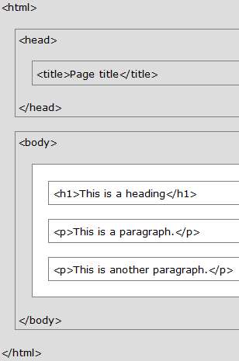

Slide 24
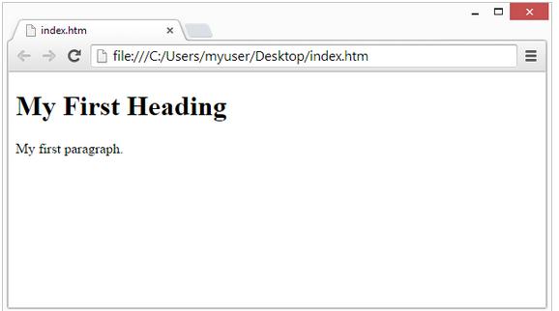
<!DOCTYPE html>
<html>
<body>
<h1>My First Heading</h1>
<p>My first paragraph.</p>
</body>
</html>

Slide 25

Heading tags define the sections on your page.
Headings are hierarchical: Heading 1, Heading 2, Heading 3, etc.
The format of Heading tags is
  <h1>This Is Heading 1</h1>
    <h2>This Is Heading 2</h2>
      <h3>This Is Heading 3</h3>

Slide 26

In the body section of your page, enclose the title with <h1></h1>, so that it looks like this:
<h1>Heading</h1>
Save the file in Notepad, then refresh the page in your browser.

Slide 27

Alignment
  The default alignment is left-justified
  To center your heading, insert the following tag <center></center>
    Remember to embed or “nest” them properly
    <h1><center>Title</center></h1>
  To do right justification, you have to create a division within the code:
    <div><div align=“right”>Content</div>

Slide 28
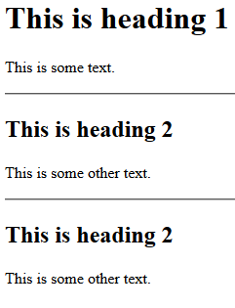
<!DOCTYPE html>
<html>
<body>
<h1>This is heading 1</h1>
<p>This is some text.</p>
<hr>
<h2>This is heading 2</h2>
<p>This is some other text.</p>
<hr>
<h2>This is heading 2</h2>
<p>This is some other text.</p>
</body>
</html>
  <h1> headings should be used for main headings, followed by <h2> headings, then the less important <h3>, and so on.
  The <hr> tag defines a thematic break in an HTML page, and is most often displayed as a horizontal rule.
  The <hr> element is used to separate content (or define a change) in an HTML page

Slide 29
<!DOCTYPE html>
<html>
<head>
<title>My First HTML</title>
<meta charset="UTF-8">
</head>
<body>
<p>The HTML head element contains meta data.</p>
<p>Meta data is data about the HTML document.</p>
</body>
</html>
The HTML <head> element has nothing to do with HTML headings.
The <head> element is a container for metadata. HTML metadata is data about the HTML document. Metadata is not displayed.
The <head> element is placed between the <html> tag and the <body> tag

Slide 30

Insert the <p> tag at the beginning of each paragraph and </p> at the end.
Otherwise, lines of text will appear as a single paragraph in browser, even if you have line breaks in text file.
To put a line break in, use the <br> tag

Slide 31
<!DOCTYPE html>
<html>
<body>
<p>If you want to go for job searching press the link is given below <br>
<a href="http://bdjobs.com/">This is a link</a>
</p>
</body>
</html>
HTML paragraphs are defined with the <p> tag
HTML links are defined with the <a> tag
Most browsers will display HTML correctly even if you forget the end tag

Slide 32
<!DOCTYPE html>
<html>
<body>
<p>The pre tag preserves both spaces and line breaks:</p>
<pre>
My Bonnie lies over the ocean.
My Bonnie lies over the sea.
My Bonnie lies over the ocean.
Oh, bring back my Bonnie to me.
</pre>
</body>
</html>
Output
The pre tag preserves both spaces and line breaks:
My Bonnie lies over the ocean.
My Bonnie lies over the sea.
My Bonnie lies over the ocean.
Oh, bring back my Bonnie to me.
<pre> element is displayed in a fixed-width font (usually Courier), and it preserves both spaces and line breaks
<!DOCTYPE html>
<html>
<body>
<p>In HTML, spaces and new lines are ignored:</p>
<p>
My Bonnie lies over the ocean.
My Bonnie lies over the sea.
My Bonnie lies over the ocean.
Oh, bring back my Bonnie to
me.
</p>
</body>
</html>
Output
In HTML, spaces and new lines are ignored:
My Bonnie lies over the ocean. My
Bonnie lies over the sea. My Bonnie
lies over the ocean. Oh, bring back
my Bonnie to me.

Slide 33
<!DOCTYPE html>
<html>
<body>
<img src="job.jpg" alt="image unload" width="104" height="142">
</body>
</html>
HTML images are defined with the <img> tag.
The source file (src), alternative text (alt), width, and height are provided as attributes:

Slide 34
An HTML element usually consists of a start tag and end tag, with the content inserted in between:
<tagname>Content goes here...</tagname>
HTML elements can be nested (elements can contain elements)
Do Not Forget the End Tag: Although Some HTML elements will display correctly, even if you forget the end tag
HTML elements with no content are called empty elements.
  <br> is an empty element without closing tag(<br> tag defines line break).
  Empty elements can be "closed" in the opening tag like this: <br />.
  HTML5 does not require empty elements to be closed.
HTML tags are not case sensitive: <P> means the same as <p>.

Slide 35
All HTML elements can have attributes
Attributes provide additional information about an element
Attributes are always specified in the start tag
Attributes usually come in name/value pairs like: name="value“
The title Attribute is added to the <p> element. The value of the title attribute will be displayed as a tooltip when you mouse over the paragraph
HTML links are defined with the <a> tag. The link address is specified in the href attribute
Size Attributes: HTML images are defined with the <img> tag. The filename of the source (src), and the size of the image (width and height) are all provided as attributes.
alt Attribute: The alt attribute specifies an alternative text to be used, when an image cannot be displayed.

Slide 36
Attribute | Description
alt | Specifies an alternative text for an image, when the image cannot be displayed
href | Specifies the URL (web address) for a link
id | Specifies a unique id for an element
src | Specifies the URL (web address) for an image
style | Specifies an inline CSS style for an element
title | Specifies extra information about an element (displayed as a tool tip)

Slide 37

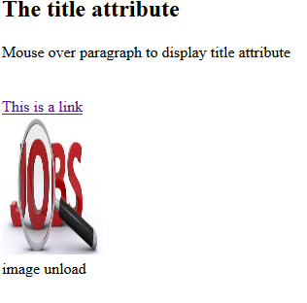
<!DOCTYPE html>
<html>
<body>
<h2>The title attribute</h2>
<p title="I'm a tooltip">
Mouse over paragraph to display title attribute
</p> <br>
<a href="https://www.bdjobs.com">This is a link</a> <br>
<img src="job.jpg" width="104" height="142"> <br>
<img src="jobs.jpg" alt="image unload" width="104" height="142">
</body>
</html>

Slide 38

<body bgcolor=“colorname”>
No closing tag required
You can use the names of colors: green, pink, etc.
You can also use hex values for the colors - an alphanumeric code that gives different shades of green, pink, etc.

Slide 39
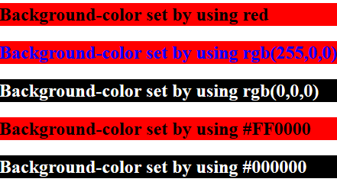
<!DOCTYPE html>
<html>
<body>
<h2 style="background-color:red">
Background-color set by using red
</h2>
<h2 style="background-color:rgb(255,0,0);color:blue">
Background-color set by using rgb(255,0,0)
</h2>
<h2 style="background-color:rgb(0,0,0);color:white">
Background-color set by using rgb(0,0,0)
</h2>
<h2 style="background-color:#FF0000">
Background-color set by using #FF0000
</h2>
<h2 style="background-color:#000000;color:white">
Background-color set by using #000000
</h2>
</body>
</html>

Slide 40

You can format text using HTML font tags:
  <em></em> Renders as italic text style.
  <strong></strong> Renders as bold text style.
  <font size=“#”></font> Renders text different sizes. The attribute values range from 1 - 7, with 1 being the smallest.
  <font color=“color”></font> Renders text a different color
  You can combine the font color and font size tags as follows:
  <font color=“color”; size=“#”></font>
Notes:
Note that the font size attributes work in the opposite direction from the heading values. For example, h1 is the largest heading, while font size 1 is the smallest font size.

Slide 41

HTML files can contain hyperlinks to files on the same computer or around the world.
3 types of links: external, internal, and “mail to”
Notes:
The “a” stands for address.

Slide 42

All Link tags require two components
  The location you want to link to
  The text that you want to appear on the page
<a href=“http://www.ucsb.edu”>Link Text</a>
In an external link, this is the web address of the site

Slide 43

An internal link is very similar to an external one.
The difference is that you are linking to another html file on your own server.
You’ll first need to decide what to name the second file - remember all lowercase, no spaces.
Then construct a link with the name of your new file: <a href=“page2.html”>Next</a>

Slide 44

These allow interested viewers to contact you.
<a href=“mailto:kknight08@gmail.com”> Contact Me</a>

Slide 45

You can insert images into HTML code.
You insert an image reference using the <img src = > tag.
For example, <img src = “zoo.gif”> inserts the zoo.gif file. No closing tag needed.
You can also specify the height and width of images to make the rest of the page load faster. <img src=“zoo.gif” height=100px width = 100px>
Upload image files with your html files.
Notes:
A note about images: you have to respect copyright when using images. It is best to use your own photos or clip art / photos that is already licensed. When scavenging images off the web, you need to look for copyright information on the site. If you cannot find that the images are copyrighted and you decide to use them, you should always give credit to the site that you took the images from. NEVER link to images hosted on someone else’s site. Always

Slide 46

Head and Body sections
Title tag: <title>
Headings: <h1>
Text formatting
Hyperlinks

Slide 47

https://www.w3schools.com/html/default.asp
http://www.tutorialspoint.com/html/

